Slide 1
Greengrass
v0.1

Slide 2
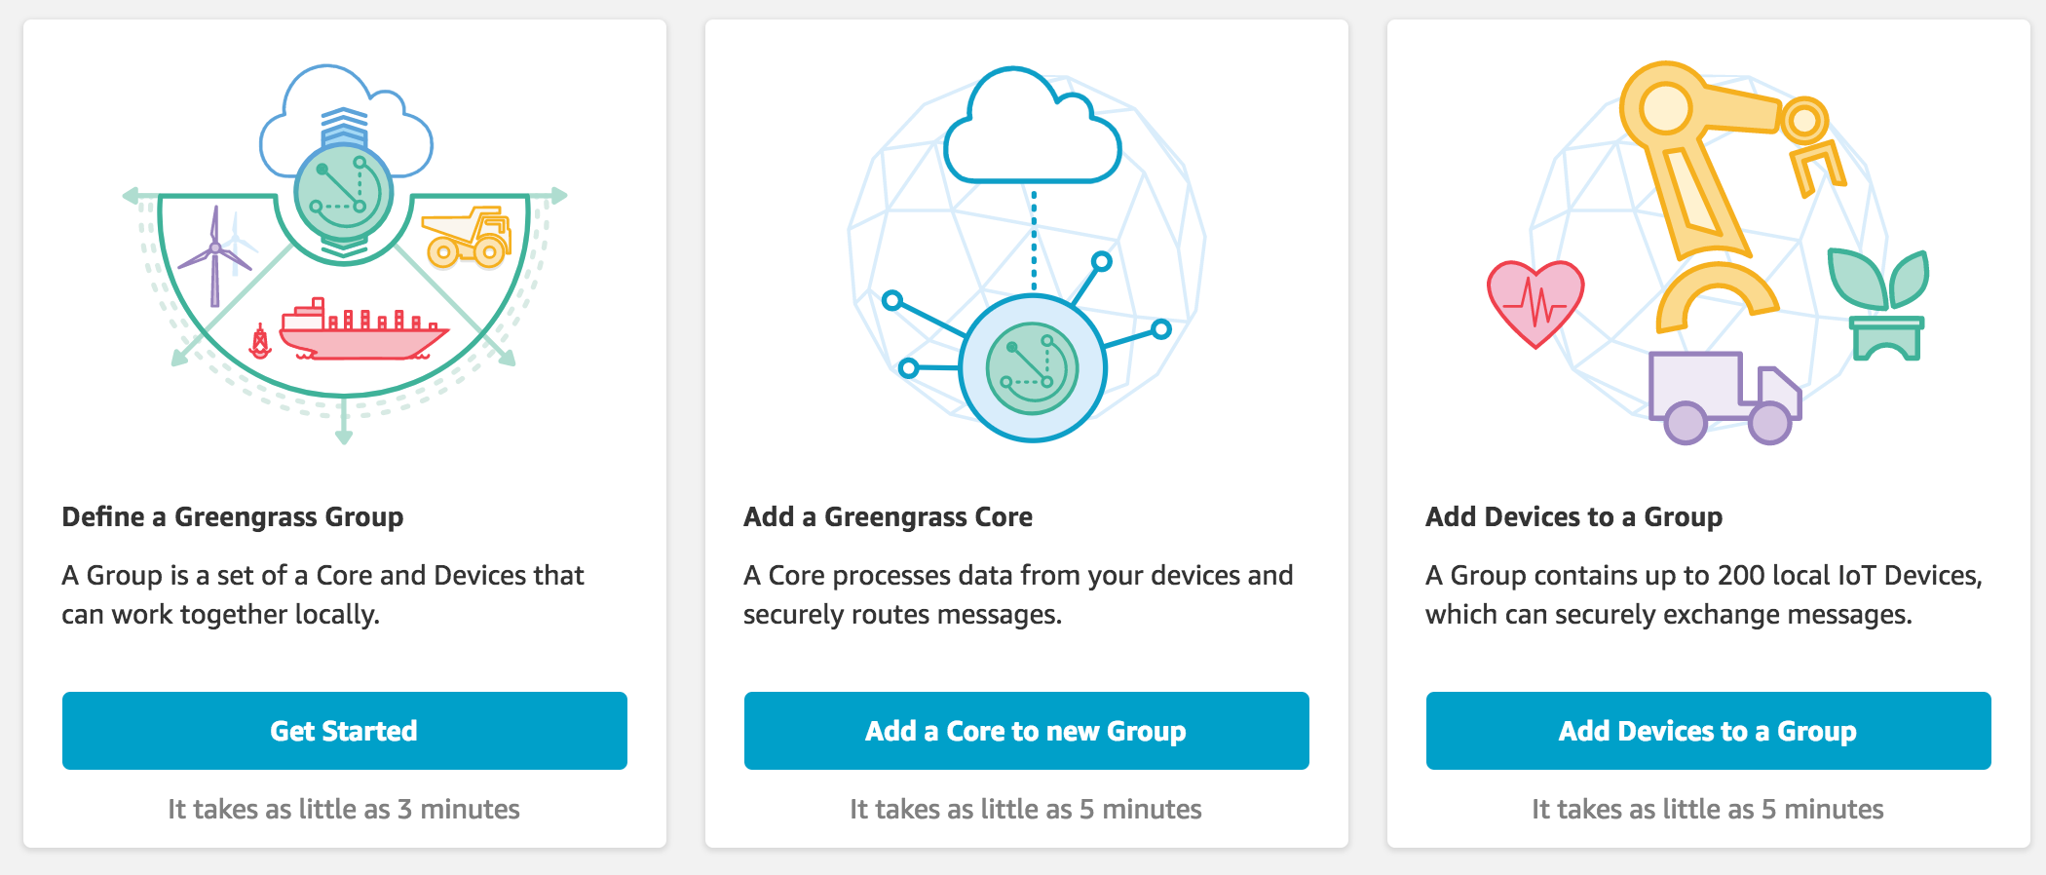
AWS Greengrass
AWS Greengrass is software that extends AWS cloud capabilities to local devices, making it possible for them to collect and analyze data closer to the source of information, while also securely communicating with each other on local networks.

Slide 3
Architecture
Developers who use AWS Greengrass can author serverless code (AWS Lambda functions) in the cloud and conveniently deploy it to devices for local execution of applications.
AWS Greengrass provides cloud-based management of applications that can be deployed for local execution. Locally deployed Lambda functions are triggered by local events, messages from the cloud, or other sources.

Slide 4
Greengrass components
Software distributions
AWS Greengrass core software
AWS Greengrass core SDK
Cloud service
AWS Greengrass API
Features
Lambda runtime
Thing shadows implementation
Message manager
Group management
Discovery service

Slide 5
Greengrass Core Software
Functionality
Allows deployment and execution of local applications created using Lambda functions and managed through the deployment API.
Enables local messaging between devices over a secure network using a managed subscription scheme through the MQTT protocol.
Ensures secure connections between devices and the cloud using device authentication and authorization.
Provides secure, over-the-air software updates of user-defined Lambda functions.
Consists of:
A message manager that routes messages between devices, Lambda functions, and AWS IoT.
A Lambda runtime that runs user-defined Lambda functions.
An implementation of the Thing Shadows service that provides a local copy of thing shadows, which represent your devices. Thing shadows can be configured to sync with the cloud.
A deployment agent that is notified of new or updated AWS Greengrass group configuration. When new or updated configuration is detected, the deployment agent downloads the configuration data and restarts the AWS Greengrass core.

Slide 6
AWS Greengrass Groups
An AWS Greengrass group definition is a collection of settings for AWS Greengrass core devices and the devices that communicate with them.

Slide 7
Security
The devices securely communicate on a local network and exchange messages with each other without having to connect to the cloud.
Greengrass provides a local pub/sub message manager that can intelligently buffer messages if connectivity is lost so that inbound and outbound messages to the cloud are preserved.
protects user data:
Through the secure authentication and authorization of devices.
Through secure connectivity in the local network.
Between local devices and the cloud.
Greengrass provides secure, over-the-air software updates of Lambda functions.

Slide 8
Devices in AWS Greengrass
AWS Greengrass cores
An AWS Greengrass core is an AWS IoT device that runs specialized AWS Greengrass software that communicates directly with the AWS IoT and AWS Greengrass cloud services.
It is an AWS IoT device with its own certificate used for authenticating with AWS IoT.
It has a device shadow and exists in the AWS IoT device registry.
AWS Greengrass cores run a local Lambda runtime, a deployment agent, and an IP address tracker that sends IP address information to the AWS Greengrass cloud service to allow AWS IoT devices to automatically discover their group and core connection information.
AWS IoT devices connected to an AWS Greengrass core.
Any AWS IoT device can connect to an AWS Greengrass core.
An AWS IoT device runs software written with the AWS IoT Device SDK.

Slide 9
Greengrass Core and IoT Device

Slide 10
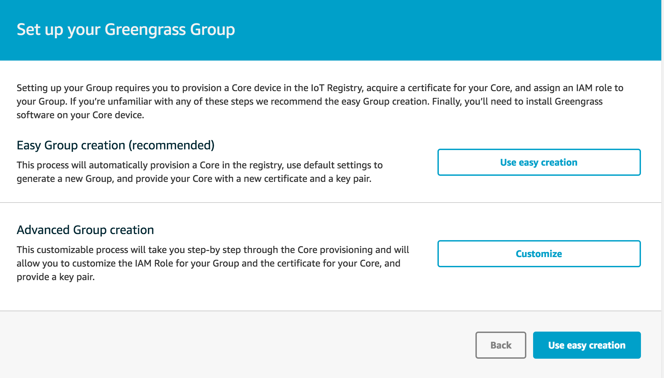
Greengrass group

Slide 11
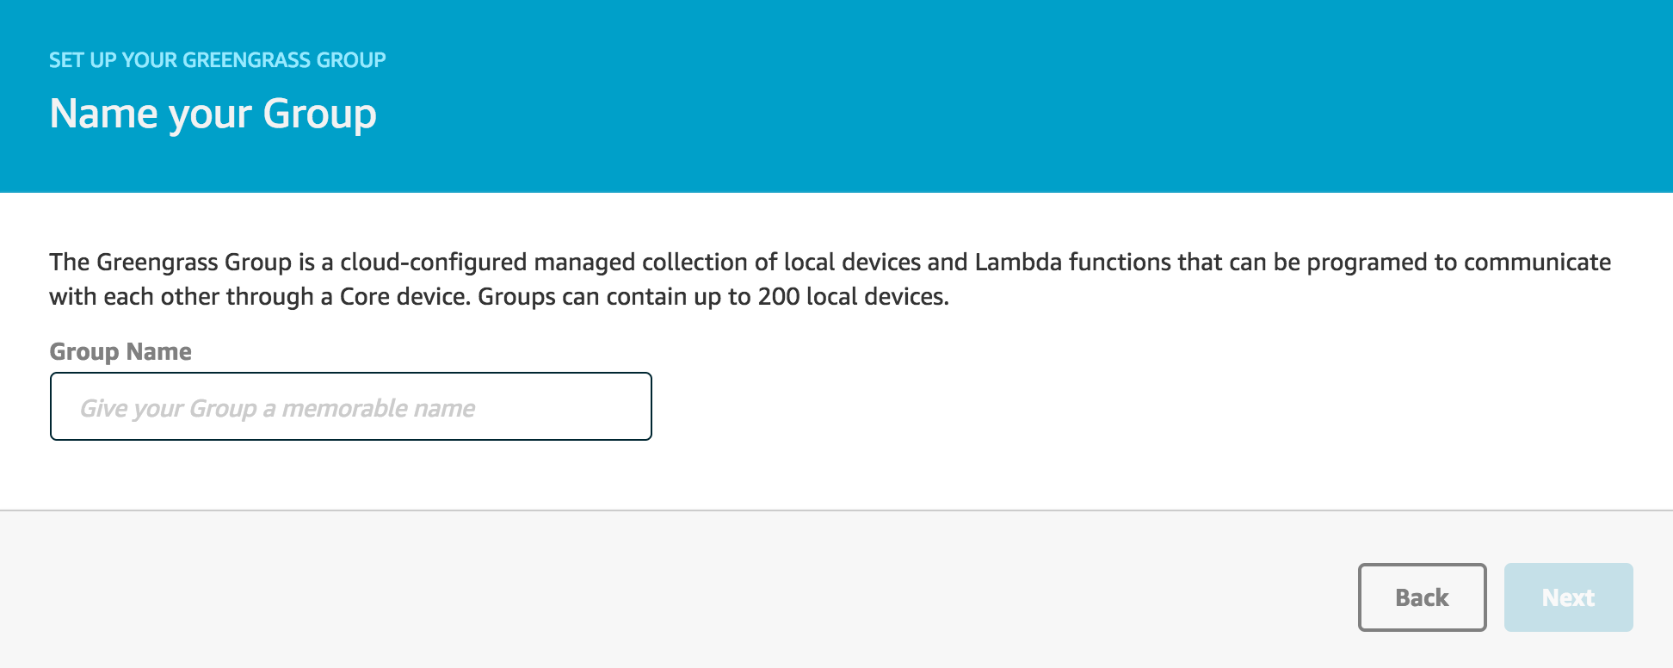
Name your group

Slide 12
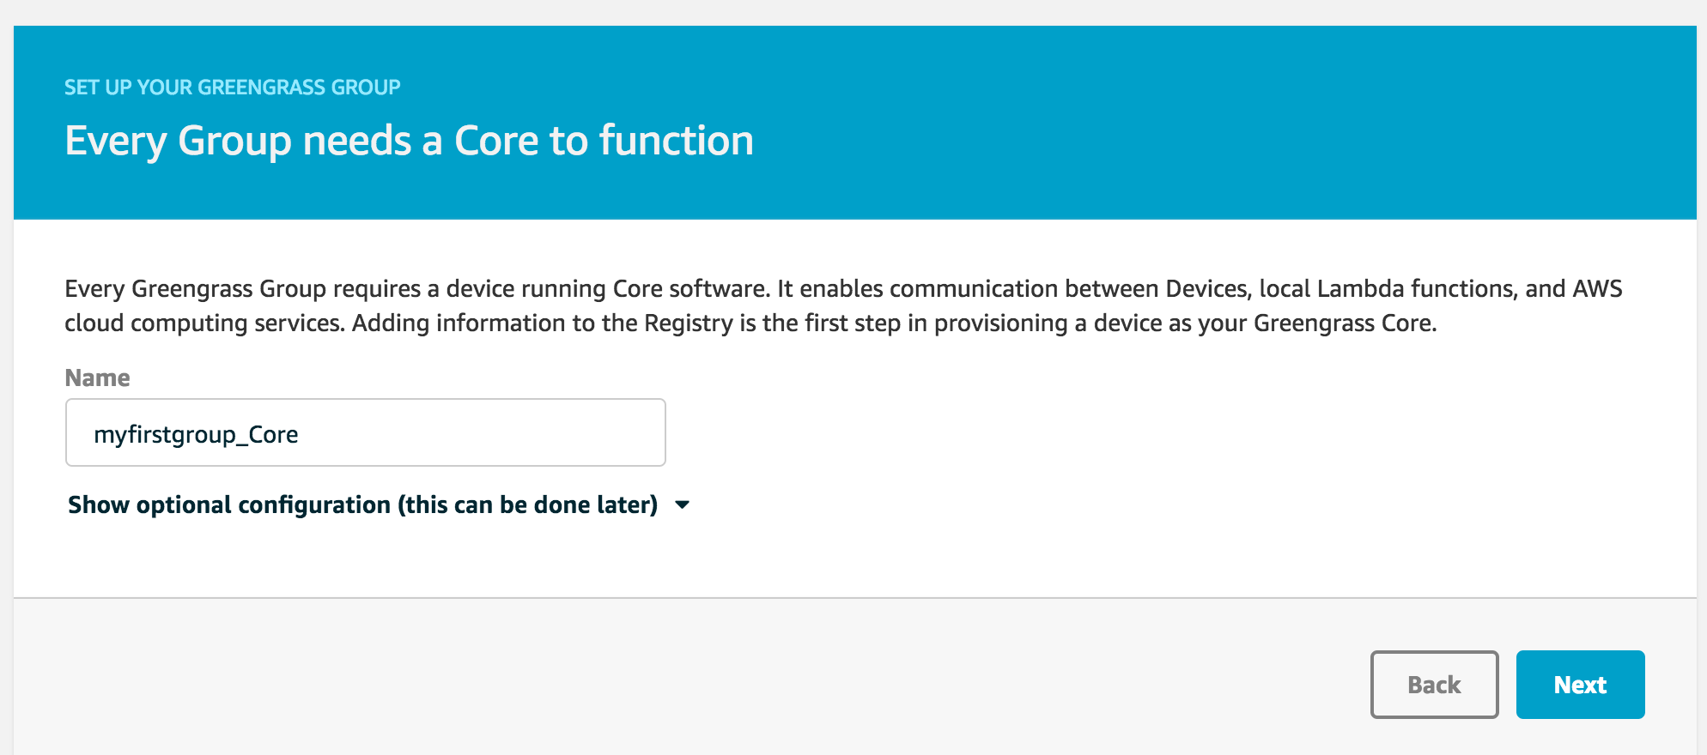
Greengrass core

Slide 13
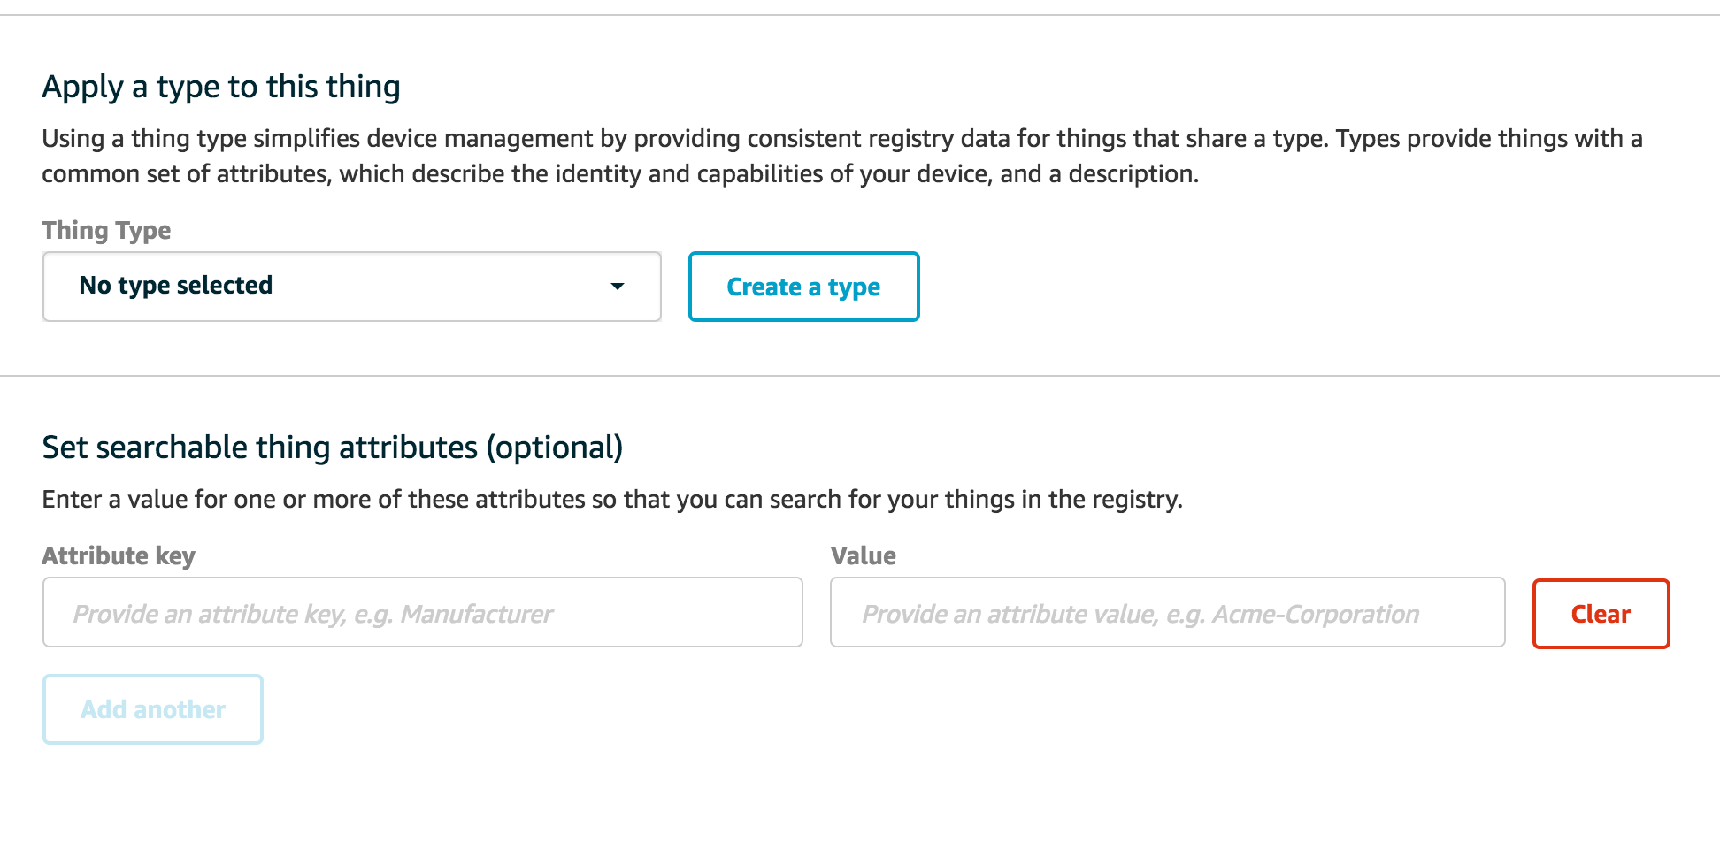
Greengrass core optional configuration

Slide 14
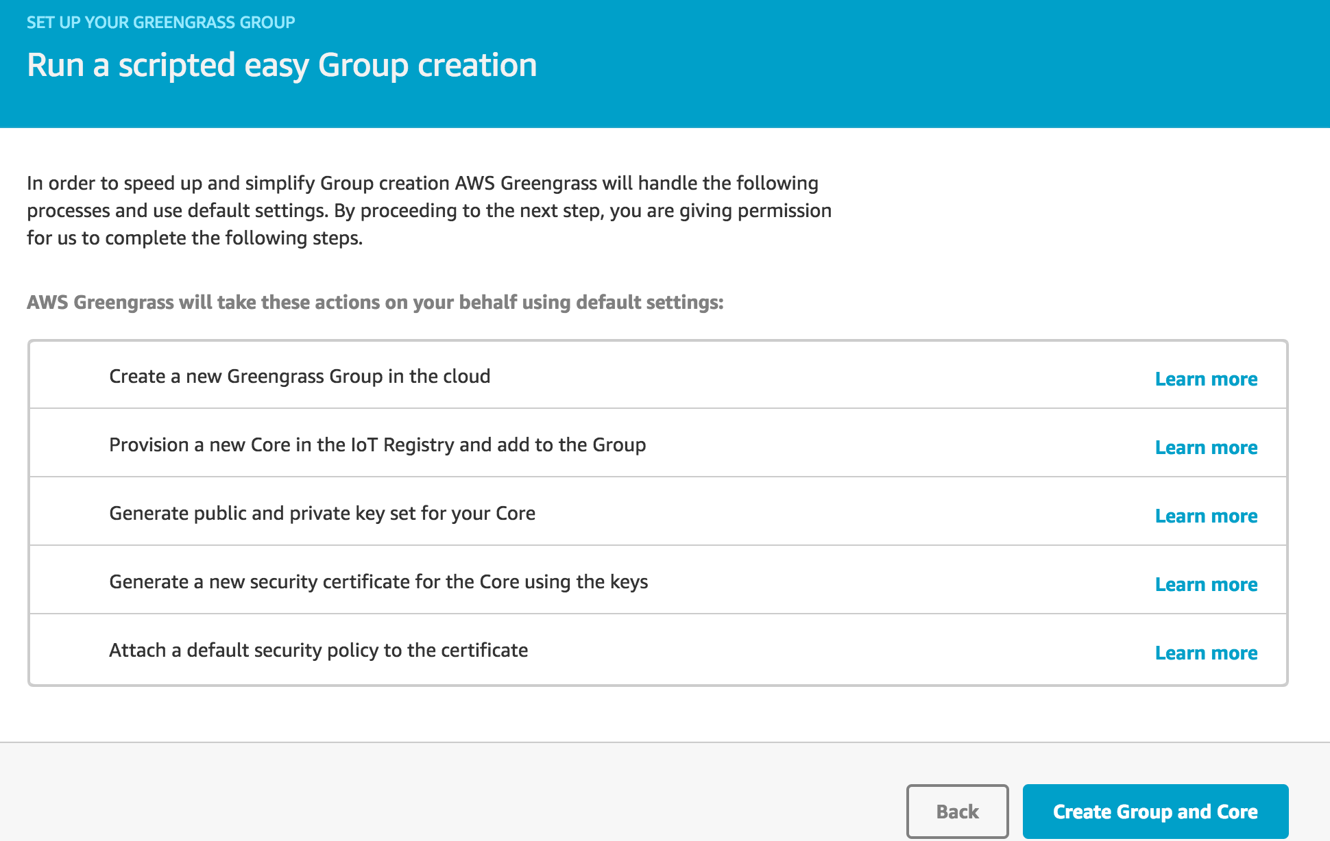

Slide 15
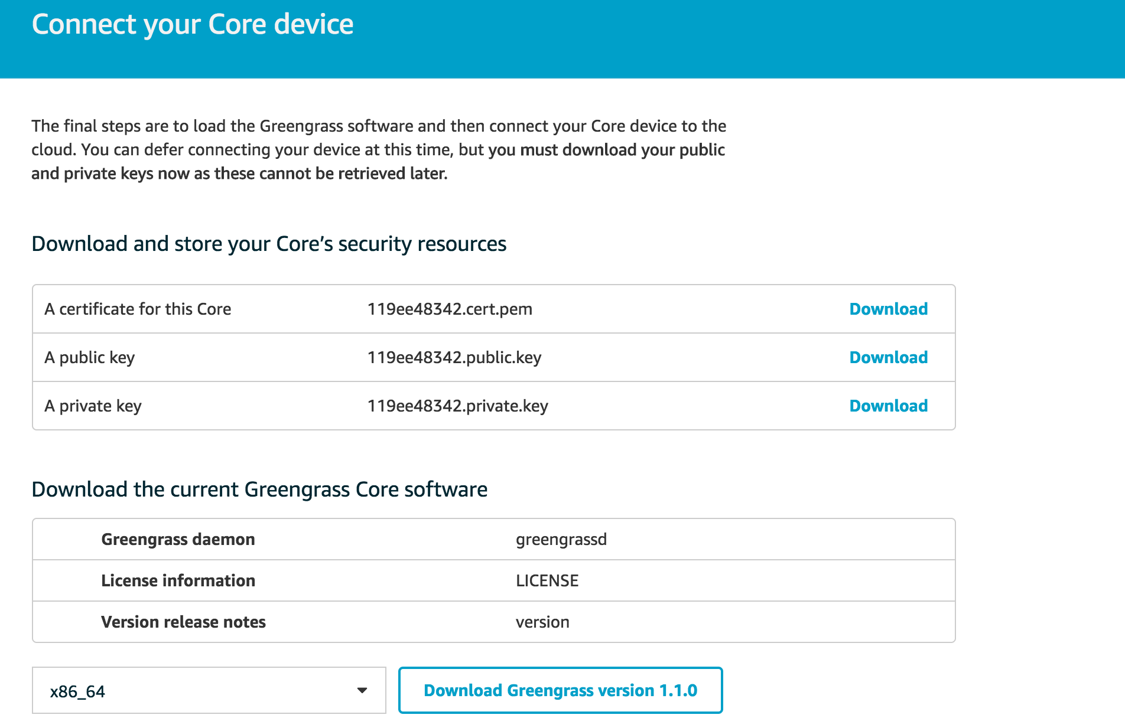
Connect core device

Slide 16
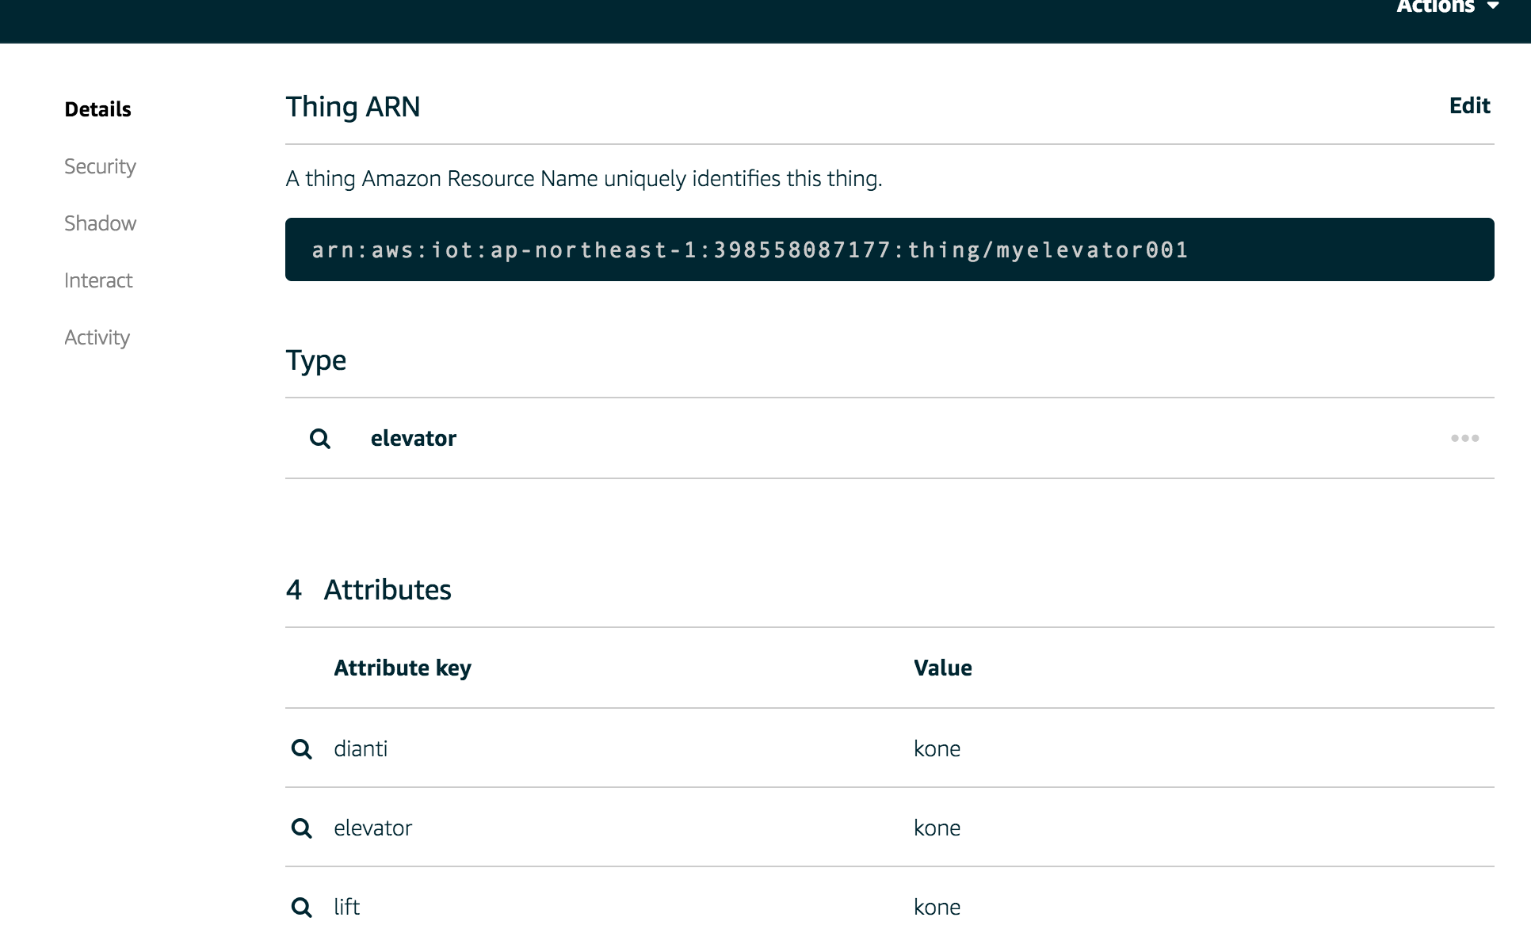
Device

Slide 18
Backup

Slide 20
IoT Ecosystem
AI Chatbot System
3
IoT Cloud Core
Implementation
Control device through conversational API
Python
Java
Spring Cloud
Nosql
Spark
Hadoop
IoT Insight Service based on leading edge technologies
2
5
Data Ingestion &
Real-time Analysis
Knowledge & Graph Analytics
ML | DL
Graph Data & Knowledge Base
NLU
SKlearn
Keras
TensorFlow
Caffe
Yolo
Faster-RCNN
Algorithms
1
Machine | Deep Learning
Connection Protocol
IoT Edge
& Devices
Cloud Native
Predictive Maintenance
& Anomaly Detection
Docker
Kubernete
4

Slide 21

IoT enabled Applications
Realtime and historical API & UI
3
Message Hub (Kafka)
Authentication & Authorization
IoT Hub
IoT Analytics
External Datastore
2
4
8
Application
Rule
Engine
(anomaly detection,filter,processor,etc)
Advanced Analytics
(enrich,convers,merge,aggregate,etc)
Action Plugins
Event
MQTT
CoAP
Plugin
External Message Hub
API
API
1
HTTP
WebSocket
API
Device
Gateway & Edge Analytics Agent
Event
Event
3rd Party
Cloud Services
Device
Device
Event
Device
Device Registry
Metadata & Event Management
Device Shadow
5
6
7
Mongo
Cassandra
Mongo
Cassandra
API
Event &
State Cache
API
API
SDK
IoT Platform

Slide 22
Conversation System
Speech Recognition
Natural Language Understanding
Dialog Engine
NLU Engine
Dialog Engine
Voice
Intent
Entity
Reference
Engine
Response Action
STT
TTS
今天天气如何？
State Management
Inbound/Outbound API
Training
Training
Text
Model Management
今天天气不错....
Model
Training Data
Pipeline Config
External System

